Slide 1
Secure data hiding in images using steganography
CAPSTONE PROJECT
Presented By: Cyber Security Internship by Edunet Foundation
Student Name : Sahil Rafique Lukade
College Name & Department : Sinhgad Institute of Technology and Science. Information Technology Department

Slide 2
OUTLINE
Problem Statement
Technology used
Wow factor
End users
Result
Conclusion
Git-hub Link
Future scope

Slide 3
Problem Statement
The problem is to securely hide sensitive data within images using steganography, ensuring the data is concealed without visible distortion. Only authorized users with a passcode can retrieve the hidden information, maintaining privacy and security.

Slide 4
Technology used
Libraries:
OpenCV: For image processing, manipulation, and saving.
NumPy: For numerical operations, particularly pixel manipulation.
Platforms:
Python: The primary programming language for implementation.
Windows/Linux/MacOS: Supported platforms for running the solution, as the code can work across different OS environments
GitHub: For version control and code sharing.

Slide 5
Wow factors
Invisible Data Hiding: Uses LSB manipulation to hide data without visible image distortion.
Passcode Protection: Ensures only authorized users can retrieve the hidden message.
Minimal Distortion: Keeps the image quality intact, making hidden data hard to detect.
Future Cryptographic Integration: Potential to add encryption for enhanced security.

Slide 6
End users
Individuals: Users who want to securely hide personal information or messages in images.
Corporate/Private Organizations: For secure communications, where sensitive information needs to be shared in a way that does not draw attention.
Forensic Analysts: Can be used by professionals to study potential cases of hidden data or detect steganography techniques.
Cybersecurity Experts: To safeguard private communication and prevent data leakage in a covert manner.

Slide 7
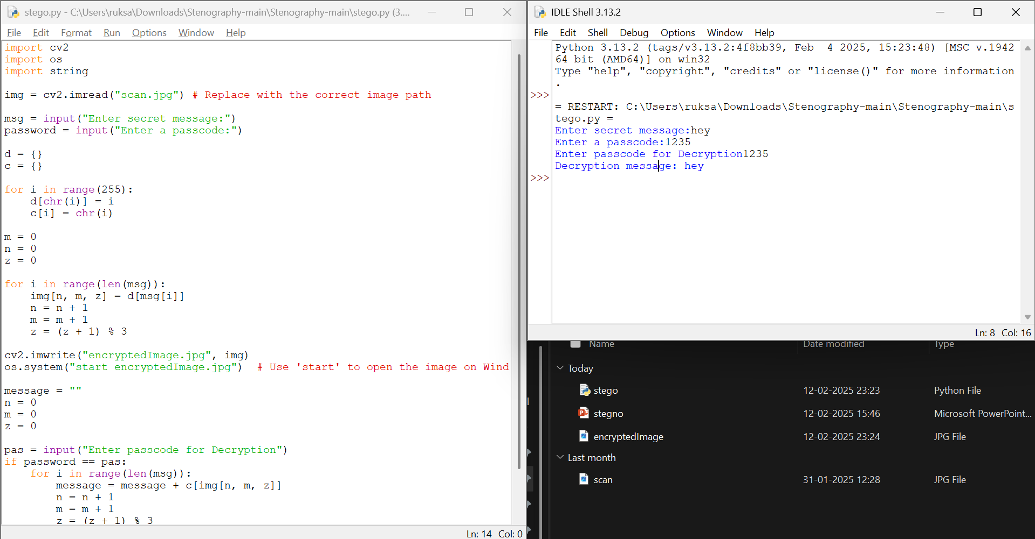
Results

Slide 8
Conclusion
Secure data hiding using steganography in images is a practical method for protecting sensitive information. While the method provides a good balance of security and invisibility, the solution can be made even more secure by combining steganography with encryption techniques. Although the current implementation is relatively simple, it forms a foundation for more advanced and robust systems

Slide 9
GitHub Link
https://github.com/srlukade/CS-AICTE-Steganography-using-Python.git

Slide 10
Future scope(optional)
Compression and Encryption Integration: The system could be extended to include image compression techniques before hiding the data and/or encrypting the message before embedding it in the image, increasing both security and efficiency.
Machine Learning for Detection: Developing AI-based models to automatically detect steganography in images, which could be used in forensic analysis or cybersecurity.
Multimedia Steganography: Extend the solution to work not just with images, but also audio, video, and other types of media.
Robustness Against Image Processing: Adding techniques to detect and recover the hidden message after common image manipulations, such as resizing, cropping, or format conversion.

Slide 11
THANK YOU

